Slide 1
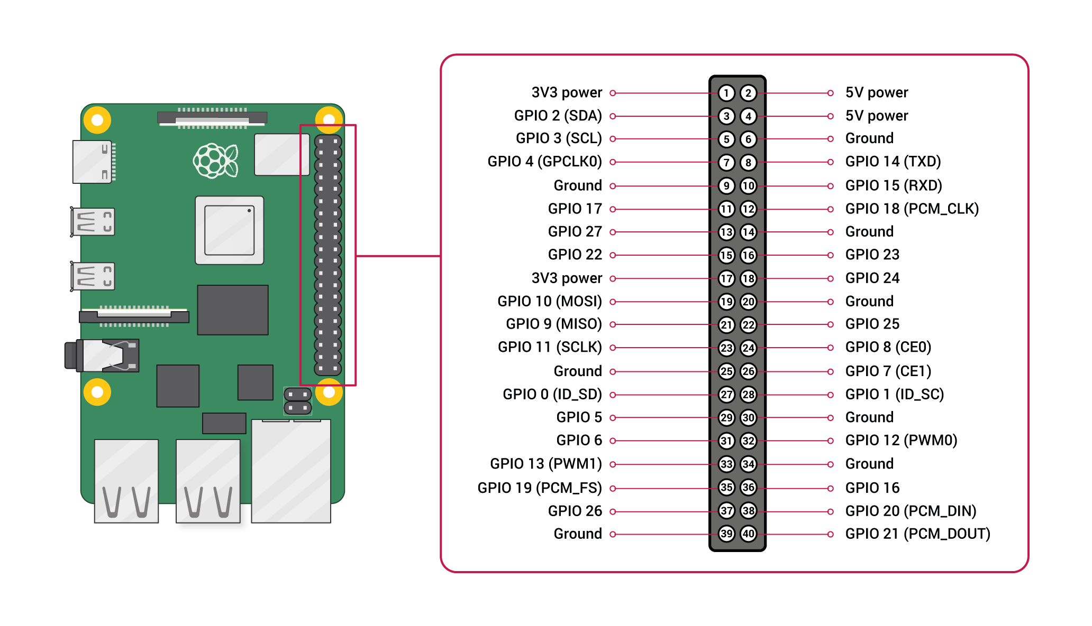





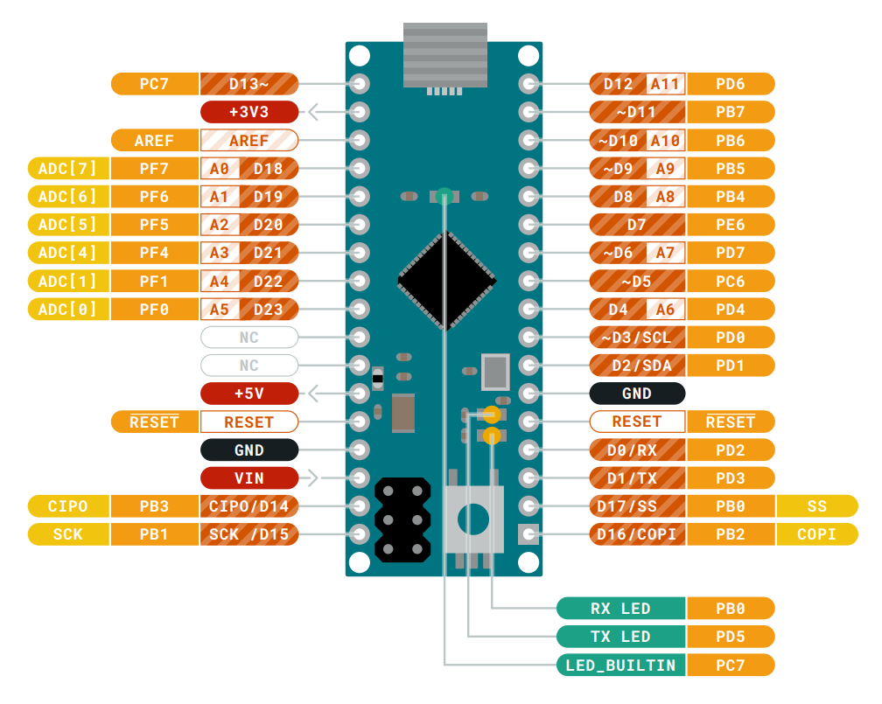
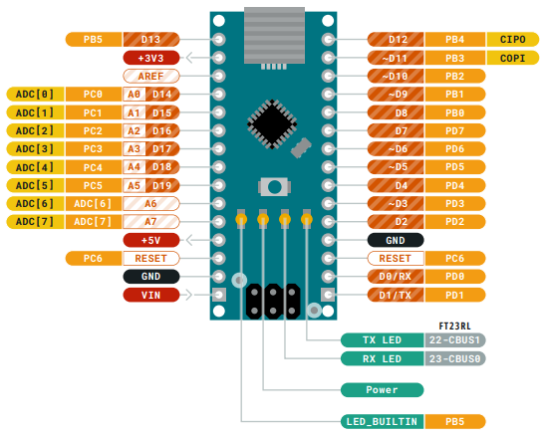
Power Bank
Raspberry Pi 4B
USB-A 2
USB-A 1
USB-C
Left Indicator
Right Indicator
USB-A 1
USB-A 2
5.5mm/2.1mm DC
Pit Crew
Power Supply
5V
GND
Micro USB
Mini USB
S
HES 5
-
+
S
HES 4
-
+
S
+
-
Voltage Sensor
S
HES 3
-
+
S
HES 2
-
+
Arduino Nano
Arduino Micro
S
HES 1
-
+

